Slide 1
First steps into Duckietown

Slide 2
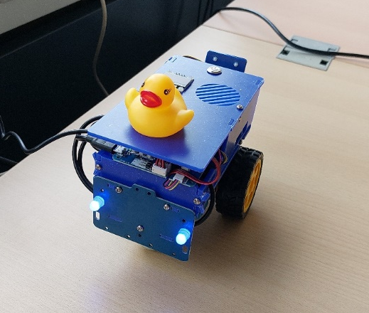
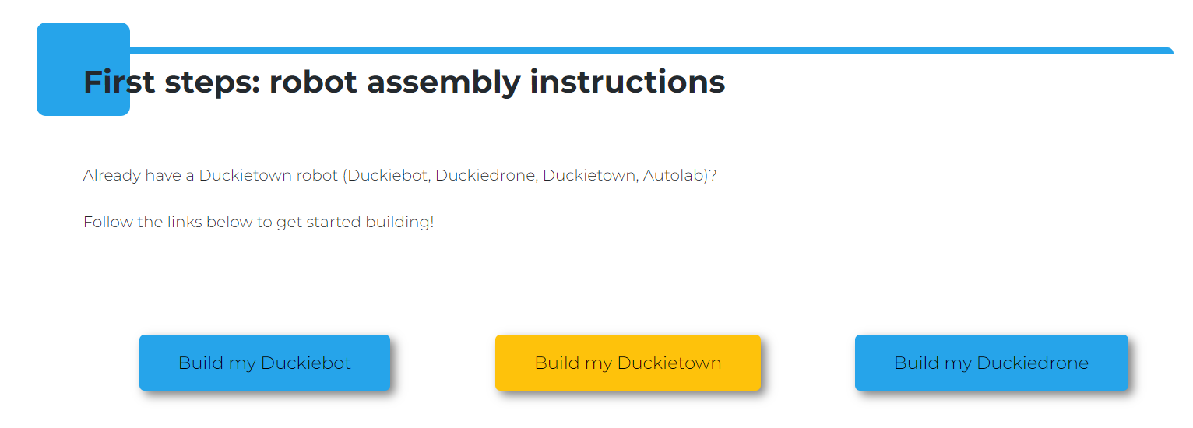
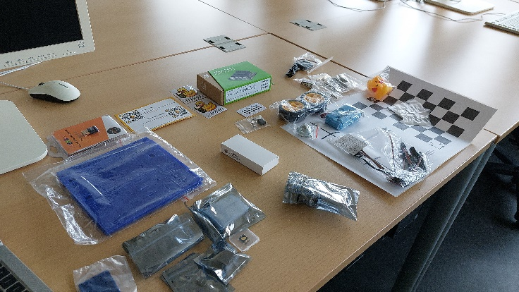
Assemblying the Duckiebot
https://duckietown.com/get-started/

Slide 3
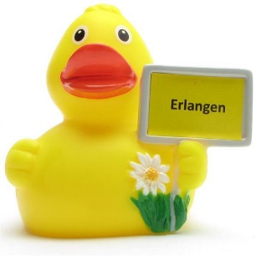
Software
Duckietown development environment (Git, Docker and Duckietown Shell)
Recommended Ubuntu 20.04 or 22.04 →VM on PC
“Duckietown uses DockerHub to distribute the containerized version of its software modules, and most Duckietown procedures entail some docker operations behind the scenes.”
Dts (Duckietown shell)
Burn the SD card

Slide 4
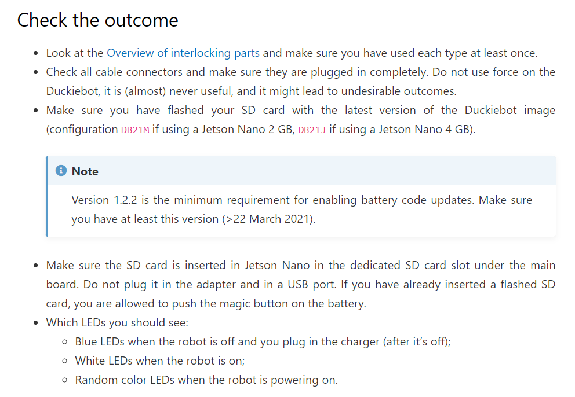

Check if the Duckiebot Works – TO DO
Future work in coming days:
Do the configuration and downloads again on the laptop and then test Duckiebot

Slide 5
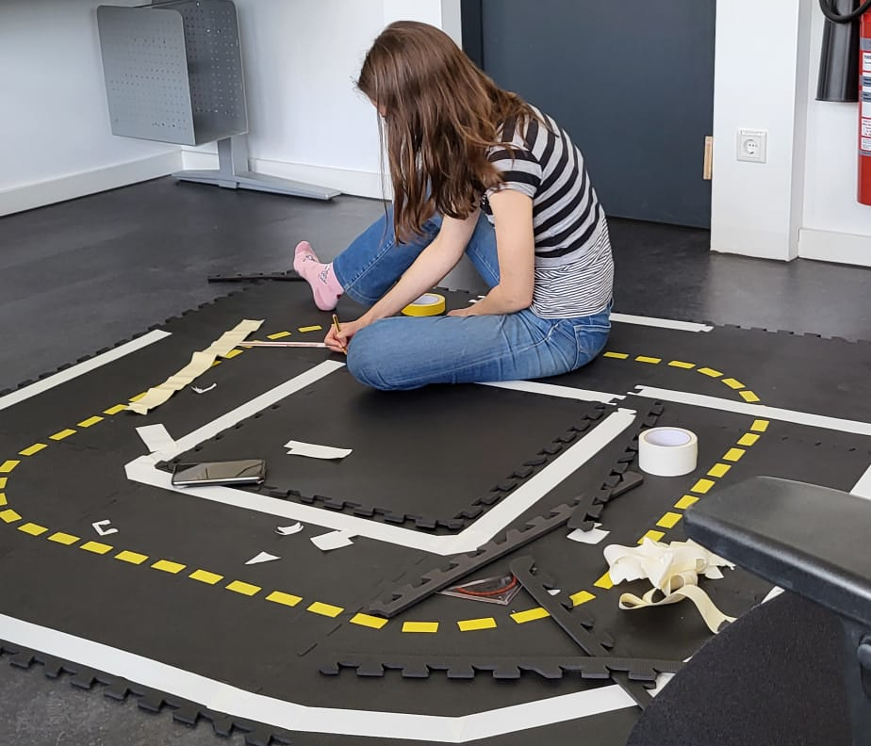
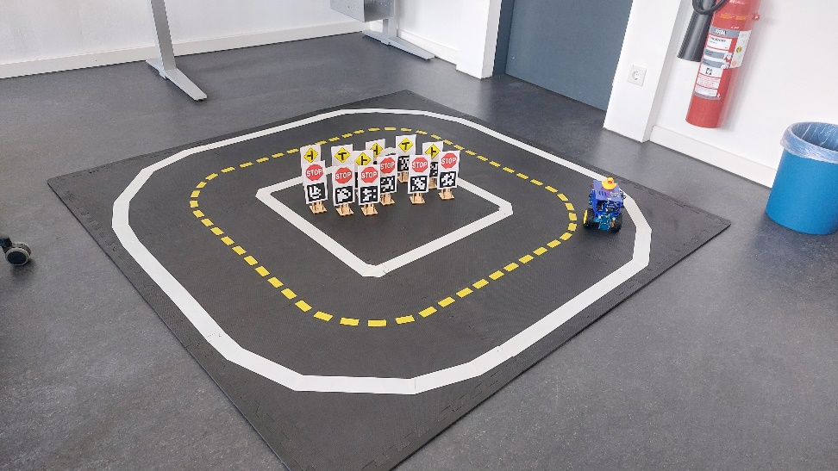
Duckietown assembly

Slide 6
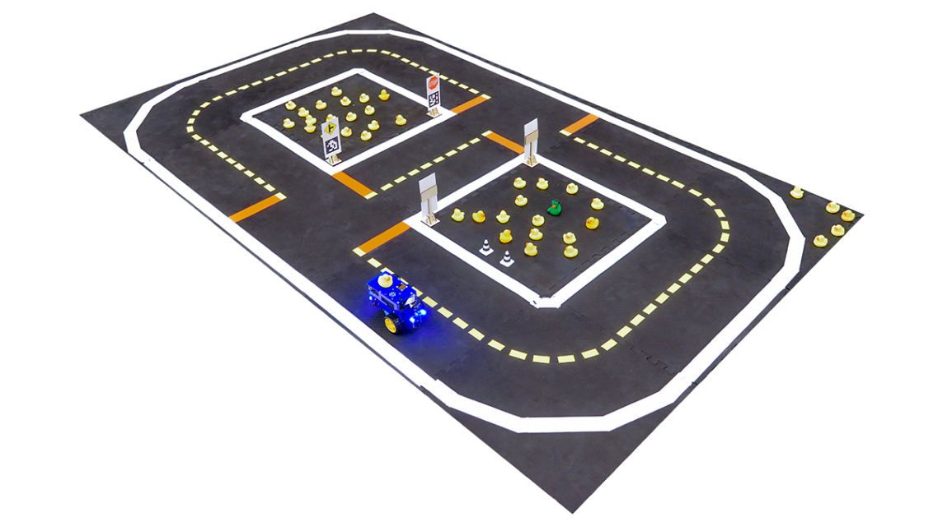
More future work
Test a basic functional demo (on webpage, first steps in duckietown)
Extended version.
Thesis: trajectory planning
algorithm to work with the robot.
Details about it, how, papers to read…

